Slide 1


Slide 2

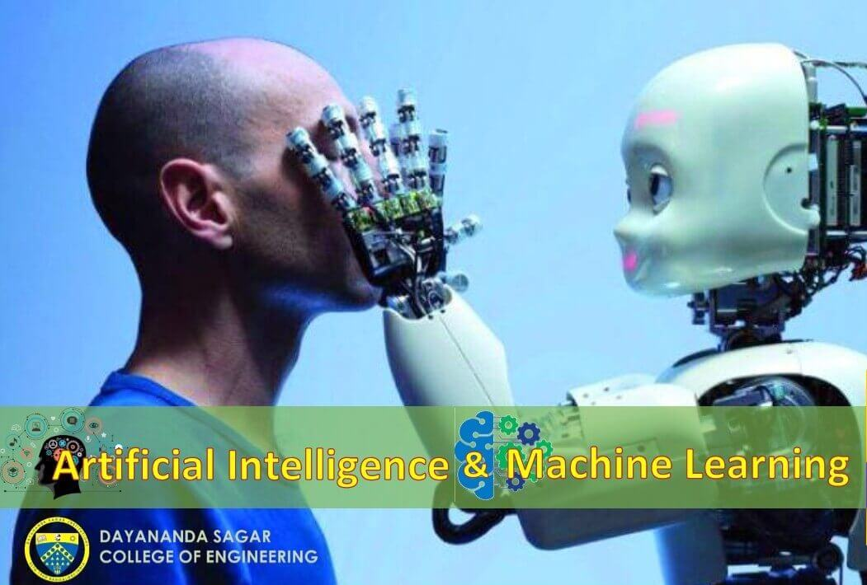
DAYANANDA SAGAR COLLEGE OF ENGINEERING
PROJECT NAME =Implementaion of Image Recognition for Human detection in Underwater Images.
Pro. RAMYA
(Guide Name)
Dr . VINDHAYA
(Head of the Department)
Notes:
YAYASHVINI MAM

Slide 3




Team Members
Ayush Aditya (1DS20AI015)
Praveen Yadav
(1DS20AI042)
Yash Rathi
(1DS20AI057)
Om Prakash Kumar
(1DS21AI401)

Slide 4
PROJECT INTRODUCTION
Artificial neural networks (ANNs) are a type of machine learning algorithm inspired by the structure and function of biological neurons. ANNs have been successfully applied to a wide range of applications, including image recognition, speech recognition, and natural language processing. One particular area where ANNs have shown promise is in the field of image recognition for underwater images. Underwater images present unique challenges due to factors such as poor visibility , color distortion, and occlusion. ANNs can help overcome these challenges by learning to recognize patterns and features in the images that are relevant for classification. By evaluating the performance of ANNs on underwater image datasets, we hope to provide insights into the strengths and limitations of these technologies for this application. This could lead to the development of more accurate and efficient image recognition systems for underwater environments, which would have important implications for fields such as marine biology, oceanography, and underwater robotics.

Slide 5
Here are 5 key points to consider when applying artificial neural network technology to image recognition for underwater images:
1. Pre-processing: Pre-processing techniques such as color correction, image enhancement, and noise reduction can improve the quality of the underwater images and increase the accuracy of the neural network's predictions.
2. Data augmentation: Due to the limited availability of underwater image datasets, data augmentation techniques such as flipping, rotation, and scaling can be used to generate additional training data and improve the generalization of the neural network.
3. Network architecture: The choice of neural network architecture depends on the specific task and the available computational resources. Convolutional neural networks (CNNs) are commonly used for image recognition tasks due to their ability to extract features from images.
4. Training: Training the neural network requires a large amount of data and computational resources. The optimization of the network parameters, such as the learning rate and batch size, can also affect the performance of the network.
5. Evaluation: The performance of the neural network can be evaluated using metrics such as accuracy, precision, recall, and F1 score. Cross-validation techniques can also be used to assess the generalization of the network to new data.

Slide 6
PROBLEM STATEMENT
Given a set of underwater images with varying degrees of noise, distortion, and lighting conditions, the task is to develop an accurate and efficient image recognition system using artificial neural networks. The system should be able to classify the images into predefined categories such as different species of marine organisms, underwater objects, or environmental conditions. The system should also be able to handle the challenges of underwater imaging, such as limited visibility, color distortion, and noise, and provide reliable and consistent results. The goal is to develop a system that can assist marine biologists, underwater photographers, and researchers in analyzing and understanding the underwater environment and its inhabitants.

Slide 7
OBJECTIVES
Limited visibility: Underwater images can have limited visibility due to the absorption, scattering, and attenuation of light, making it difficult to discern objects and patterns in the image.
Color distortion: The color of underwater images can be distorted due to the absorption and scattering of light, leading to color shifts and reduced color contrast.
Noise and artifacts: Underwater images can have noise and artifacts such as speckles, grains, and blurs, which can affect the quality of the image and the accuracy of the recognition system.

Slide 8
OBJECTIVES
Limited availability of labeled data: The availability of labeled underwater image datasets is limited, making it difficult to train accurate and robust recognition systems.
Hardware limitations: The training of neural networks requires large amounts of computational resources, and underwater image recognition systems may face hardware limitations due to the high computational cost of processing large image datasets.
Complex underwater environments: The underwater environment is complex and diverse, with different types of marine organisms, objects, and environmental conditions. Developing an accurate and generalizable recognition system that can handle this complexity is a challenging task.

Slide 9
SOCIAL RELEVANCE
Conservation Efforts: Image recognition can be used to identify different species of marine life, which can help conservation efforts. By recognizing different types of marine creatures and their behaviors, researchers can better understand the ocean ecosystem and make more informed decisions about conservation measures.
Environmental Monitoring: Underwater images can be used to monitor the health of the ocean, including the impact of pollution, climate change, and other environmental factors. Image recognition technology can help automate this process by identifying changes in the underwater environment, such as the presence of harmful algal blooms or changes in water temperature.

Slide 10
SOCIAL RELEVANCE
Search and Rescue: Image recognition can be used to locate lost or missing people in the water. By analyzing underwater images, rescue teams can identify objects or people that are not visible to the naked eye, which can greatly improve search and rescue efforts.
Commercial and Recreational Activities: Image recognition can also be used for commercial and recreational activities such as fishing, scuba diving, and ocean tourism. By analyzing underwater images, businesses can better understand the behavior of marine creatures and make more informed decisions about where to fish or how to interact with marine life.

Slide 11
NOVELTY IN THE APPROACH
Object detection: Object detection techniques such as YOLO (You Only Look Once) and Faster R-CNN (Region-based Convolutional Neural Network) can be used to detect and recognize objects in underwater images.
Ensemble learning: Ensemble learning involves combining multiple models to improve the accuracy of image recognition. This approach can be particularly useful for underwater image recognition as it can help mitigate the effects of noise and poor lighting conditions.
Domain-specific datasets: Creating a domain-specific dataset can help train a model on images that are similar to the ones it is likely to encounter in real-world scenarios.

Slide 12
NOVELTY IN THE APPROACH
Data augmentation: Augmenting the dataset by adding noise, flipping, rotating, and changing brightness can help the model learn to recognize images conditions.
Preprocessing : Preprocessing techniques such as contrast enhancement, histogram equalization, and color correction can help improve the quality of underwater images.
Transfer learning: Transfer learning involves using a pre-trained model on a large dataset and fine-tuning it on the specific task. This approach can significantly improve the accuracy of image recognition for underwater images.

Slide 13
CONCLUSION
In conclusion, image recognition for underwater images can be challenging due to various factors such as low visibility, poor lighting conditions, and color distortion. However, there are several approaches that can be used to improve the accuracy of image recognition for underwater images, such as data augmentation, preprocessing, transfer learning, object detection, ensemble learning, domain-specific datasets, and sensor fusion.
A combination of these approaches can be used to develop a robust image recognition system that can accurately recognize objects in underwater environments. It is important to note that the specific approach used will depend on the specific requirements of the application, and further research and development are needed to improve the accuracy and reliability of image recognition for underwater images.

Slide 14


